Slide 1

Integrating
JavaScript
Components
Daniel Villamizar
Senior Cloud Solutions Architect - MVP
@danielvillamizara – https://www.linkedin.com/in/danielvillamizara/

Slide 2


Module
overview
Invoking JavaScript from Blazor
Wrapping components in a Razor Class
Library
Lazy loading libraries

Slide 3
Invoking
JavaScript
from
Blazor

Slide 4

In
a
Blazor WebAssembly
app,
we’re
“just”
running
a
web
page
on
the
client.
So,
JavaScript will
work
fine
here
too.

Slide 5

Not everything is possible via just .NET
JavaScript interop
-
Call into JavaScript from Blazor code
Runs on the client
-
Loaded via surrounding page

Slide 6
Blazor
and
JavaScript
Interop
.NET calls JavaScript
JavaScript calls .NET

Slide 7



Steps
to
Invoke
JavaScript
from
.NET
Register script in surrounding page
Use IJSRuntime via Dependency Injection
Call script from .NET

Slide 8

<script>
window.DoSomething
=
()
=> {
//do
some
interesting
task
here
}
</script>
Adding a Script

Slide 9
[Inject]
public IJSRuntime
JsRuntime
{
get;
set;
}
Bring in IJSRuntime

Slide 10
var
result = await
JsRuntime.InvokeAsync<object>("DoSomething",
"");
Invoking a JavaScript Function

Slide 11
Available
Methods
InvokeVoidAsync()
InvokeAsync()

Slide 12

Working
with
JavaScript
Interop
Working with JavaScript can only be
done when the component is done rendering!
Use OnAfterRenderAsync() for this

Slide 13


Demo
Showing a map on the details page

Slide 14
Map
component:
https://aka.ms/blazorworkshop

Slide 15
Wrapping Components
in
a
Razor
Class
Library

Slide 16
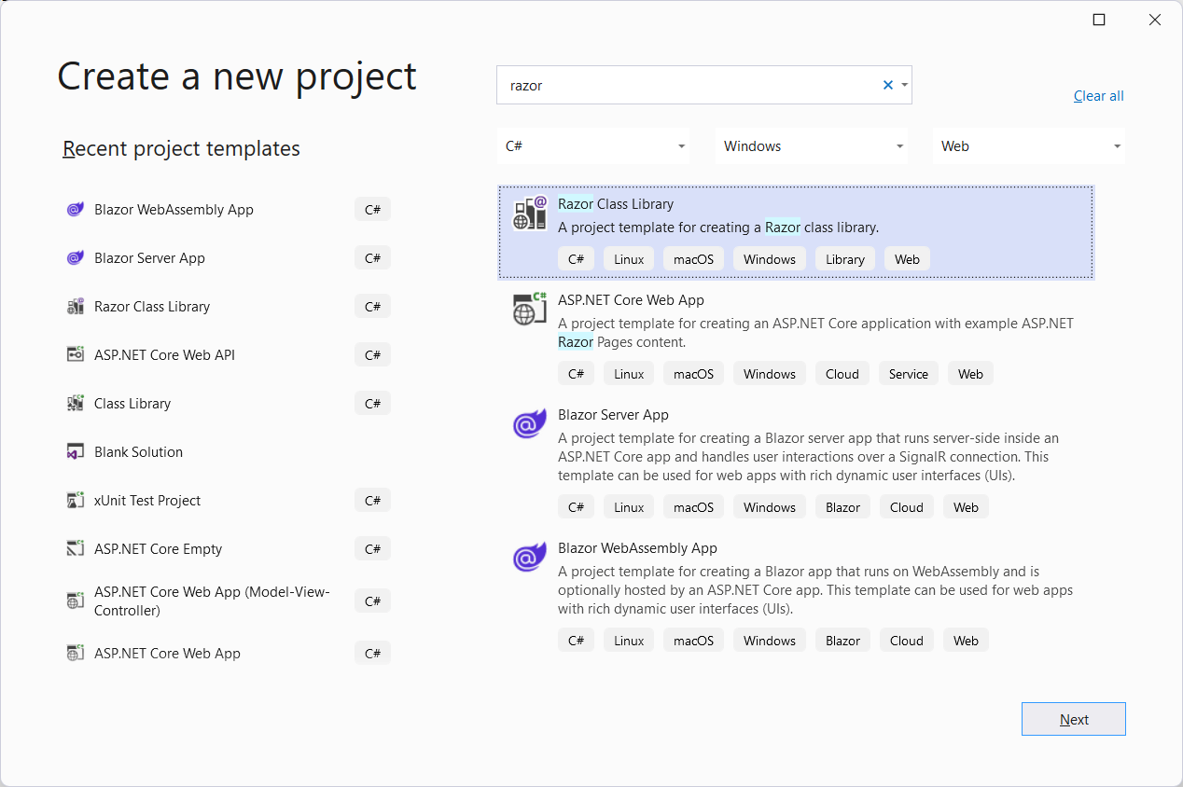
Introducing
Razor
Class
Libraries

Slide 17

Razor Class Library project
-
-
-
-
Can contain components and static assets
Reusable
NuGet package
Referenced from main project

Slide 18
@using
BethanysPieShopHRM.App.Components
<Map>...</Map>
Using a Component from an RCL
Full namespace also works
Typically @using will be placed in _Imports

Slide 19
<link
href="_content/BethanysPieShopHRM.ComponentsLibrary/leaflet/leaflet.css"
rel="stylesheet"
/>
Using Static Content from an RCL
Files must be placed in wwwroot folder

Slide 20
Demo
Moving the Map component to a Razor
Class Library
Changing the main project

Slide 21
Lazy
Loading
Libraries

Slide 22
Normal
Loading
Assemblies
Main app RCL DLL
Browser

Slide 23
Introducing
Lazy
Loading
Assemblies
Main app RCL DLL
Browser
/EmployeeDetail/3

Slide 24
<ItemGroup>
<BlazorWebAssemblyLazyLoad
</ItemGroup>
Include="BethanysPieShopHRM.ComponentsLibrary.dll"
/>
Changes to the Project File
Needs to be included for each assembly

Slide 25




Changes to
the
Router
App gets service instance injected to
LazyAssemblyLoader
support
lazy
loading:
Trigger is OnNavigateAsync()
Loads assembly via async JavaScript
call
Assembly will be loaded into runtime
Can include routable components

Slide 26
Demo
Lazy loading the RCL

Slide 27
Summary
Missing functionality in Blazor can be
added through JavaScript interop
Components can be placed in Razor Class
Library
Lazy loading can speed up application start

Slide 28

Up
next:
Authenticating
in
the
application

